Slide 1
Environmental Justice:
Climate, Health & Energy
Daniel M Kammen
Professor and Chair, Energy and Resources Group (ERG)
Professor of Public Policy
Professor of Nuclear Engineering
University of California, Berkeley
Former Science Envoy, US Department of State
September 24, 2020
http://rael.berkeley.edu

Slide 2
The Renewable and Appropriate Energy Laboratory
At UC Berkeley:
http://rael.berkeley.edu
@dan_kammen
http://rael.berkeley.edu

Slide 3
http://rael.berkeley.edu
Notes:
https://www.youtube.com/watch?v=Eu7d0BMRt0o

Slide 4
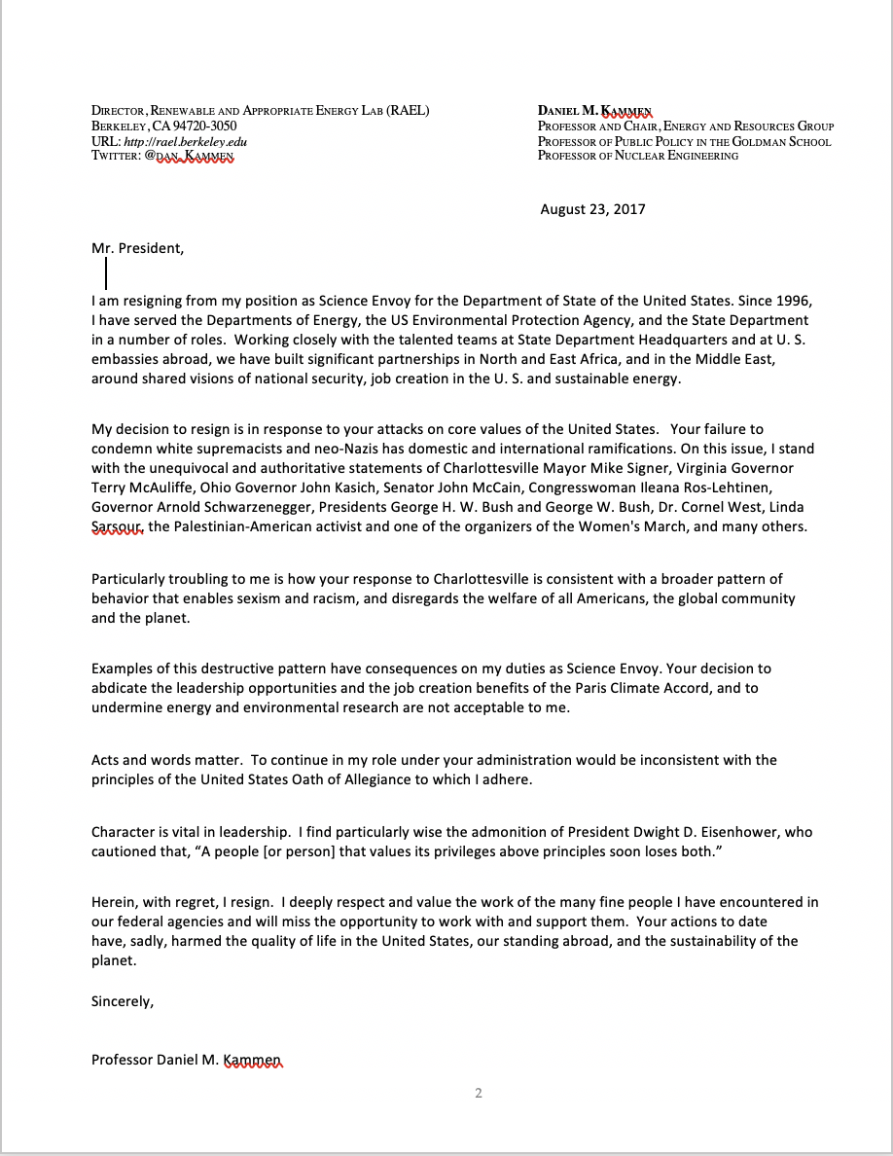
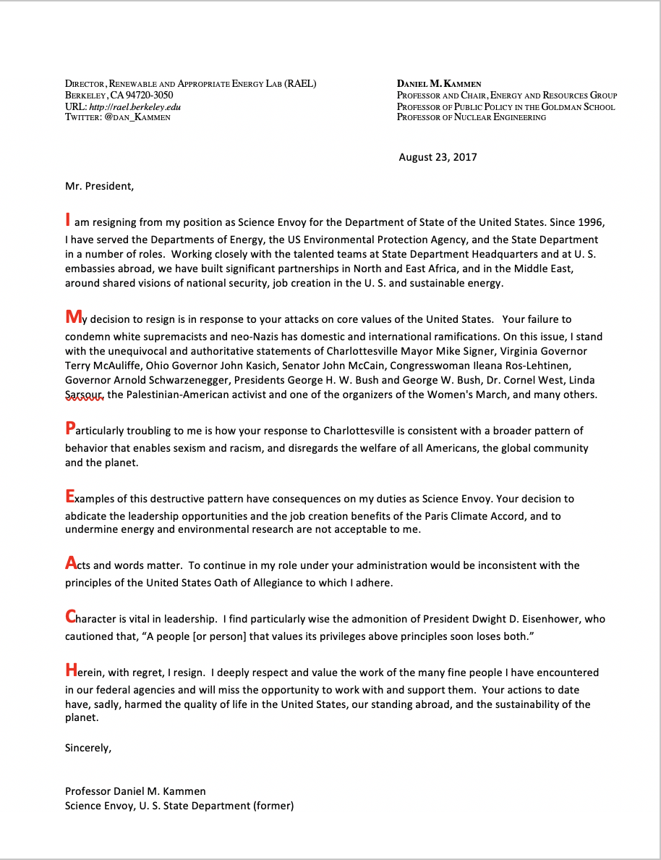
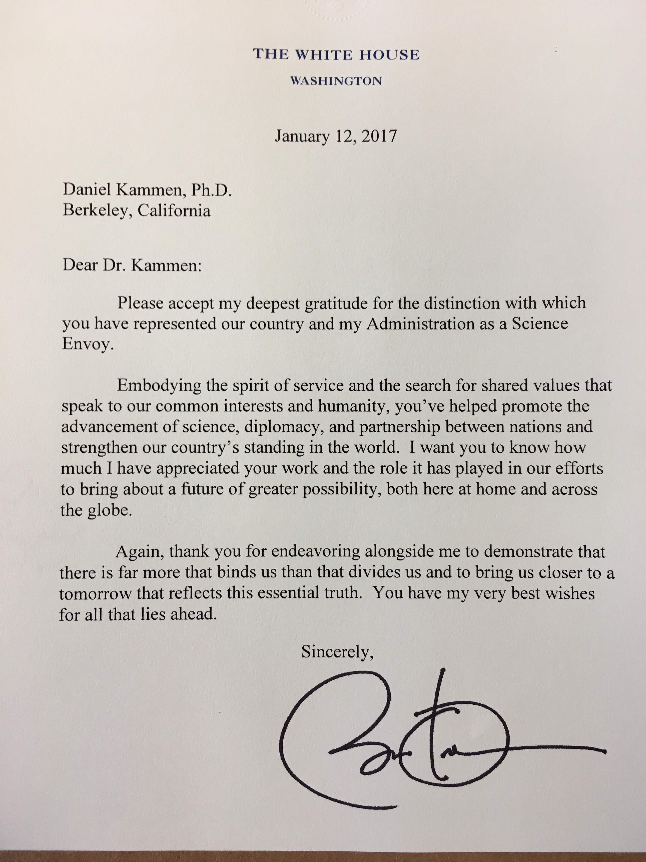
Letter to President Trump, on Twitter @dan_kammen

Slide 5
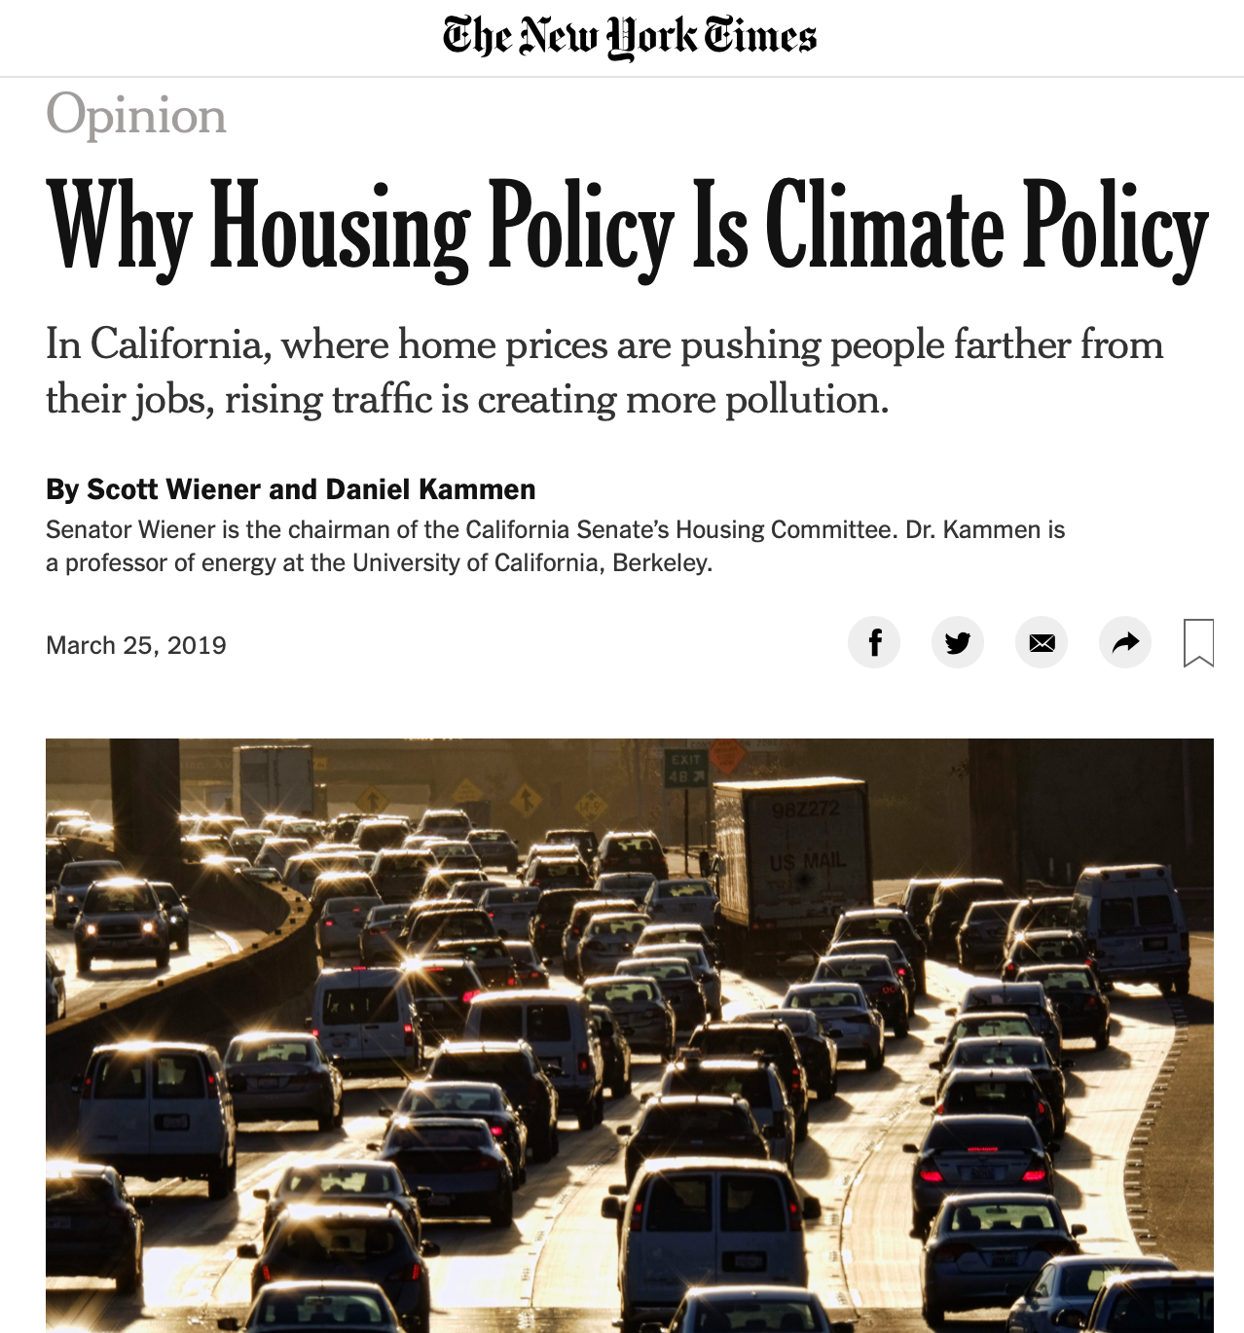
http://rael.berkeley.edu

Slide 6
https://sustainability.nus.org.uk
https://www.decoalonize.org/category/resources/
http://rael.berkeley.edu

Slide 7
Solutions Science
http://rael.berkeley.edu

Slide 8
Many Opportunities: The Green Stimulus
https://medium.com/@green_stimulus_now/a-green-stimulus-to-rebuild-our-economy-1e7030a1d9ee
Author team:
Johanna Bozuwa, J. Mijin Cha, Daniel Aldana Cohen, Billy Fleming, Jim Goodman, Ayana Elizabeth Johnson, Daniel M Kammen, Julian Brave NoiseCat, Mark Paul, Raj Patel, Thea Riofrancos (2020) “A Green Stimulus”,
https://medium.com/@green_stimulus_now/a-green-stimulus-to-rebuild-our-economy-1e7030a1d9ee
http://rael.berkeley.edu

Slide 9
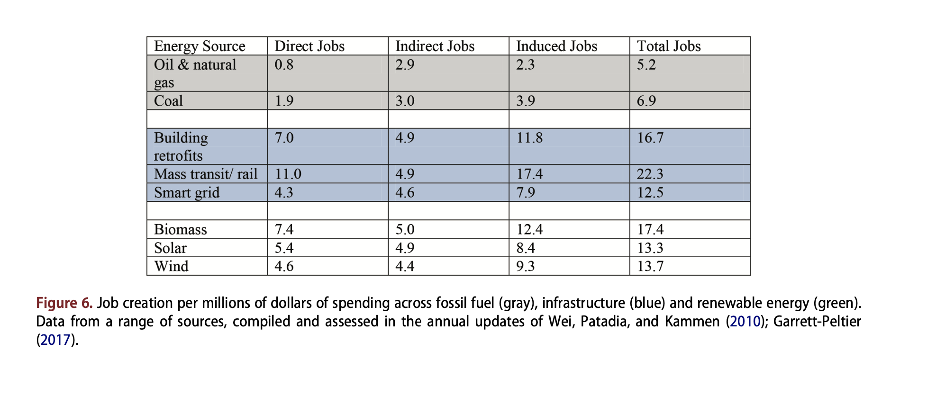
The Strong Jobs Benefits of Clean Energy
https://www.nytimes.com/interactive/2020/06/17/climate/virus-emissions-reopening.html
http://rael.berkeley.edu

Slide 10
Some examples of the change we need (if not always fast enough)
September 23, 2020:California Governor Gavin Newsom bans the sale of internal combustion engine vehicles (ICE) by 2035
https://www.sfchronicle.com/politics/article/California-to-ban-sale-of-new-gas-only-cars-in-15591347.php
September 22, 2020: China to go carbon neutral by 2060
https://www.nytimes.com/2020/09/23/world/asia/china-climate-change.html
June 21, 2020: Lyft to go all electric vehicle by 2030
https://www.sfchronicle.com/opinion/article/How-electric-vehicles-can-help-advance-social-15351293.php
January 14, 2020 - Blackrock, the world’s largest fund to divest from coal
https://www.theguardian.com/business/2020/jan/14/blackrock-says-climate-crisis-will-now-guide-its-investments
http://rael.berkeley.edu

