Slide 1
Lessons from COVID-19 for the Climate Crisis
Daniel Kammen
Energy and Resources Group (Chair)
Goldman School of Public Policy
Department of Nuclear Engineering
Director, Renewable and Appropriate Energy Laboratory
University of California, Berkeley
Former Science Envoy, United States Department of State
Fossil Free California, March 31, 2020
Notes:
Meeting URL:
https://ihe.britishcouncil.org/events/building-pipeline-incentivizing-stem-higher-education

Slide 2
Notes:
Meeting URL:
https://ihe.britishcouncil.org/events/building-pipeline-incentivizing-stem-higher-education

Slide 3
Resources:
Website: http://rael.berkeley.edu
Twitter: @dan_kammen

Slide 4
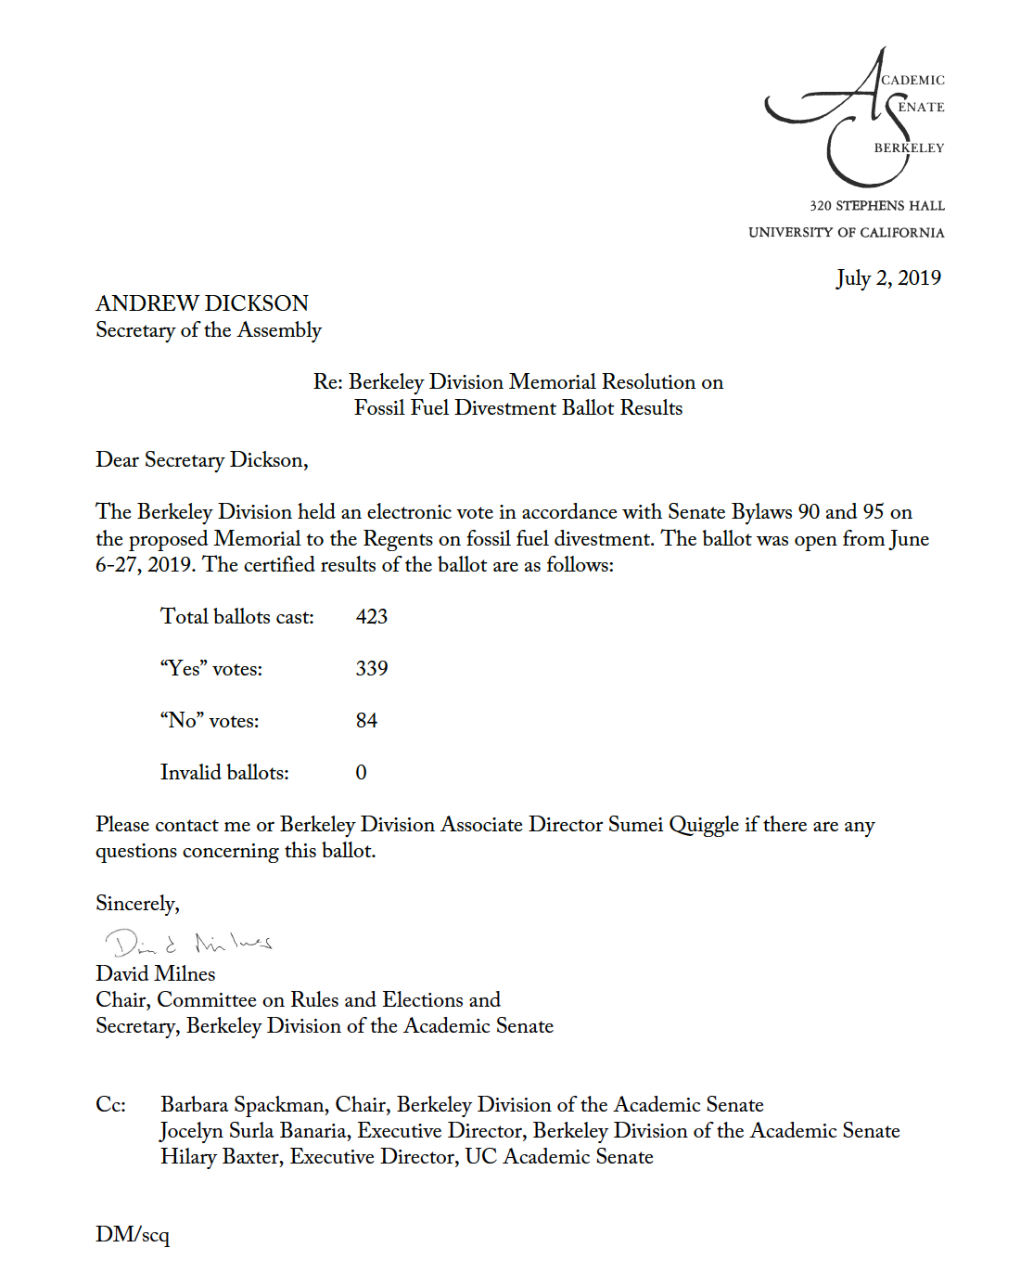
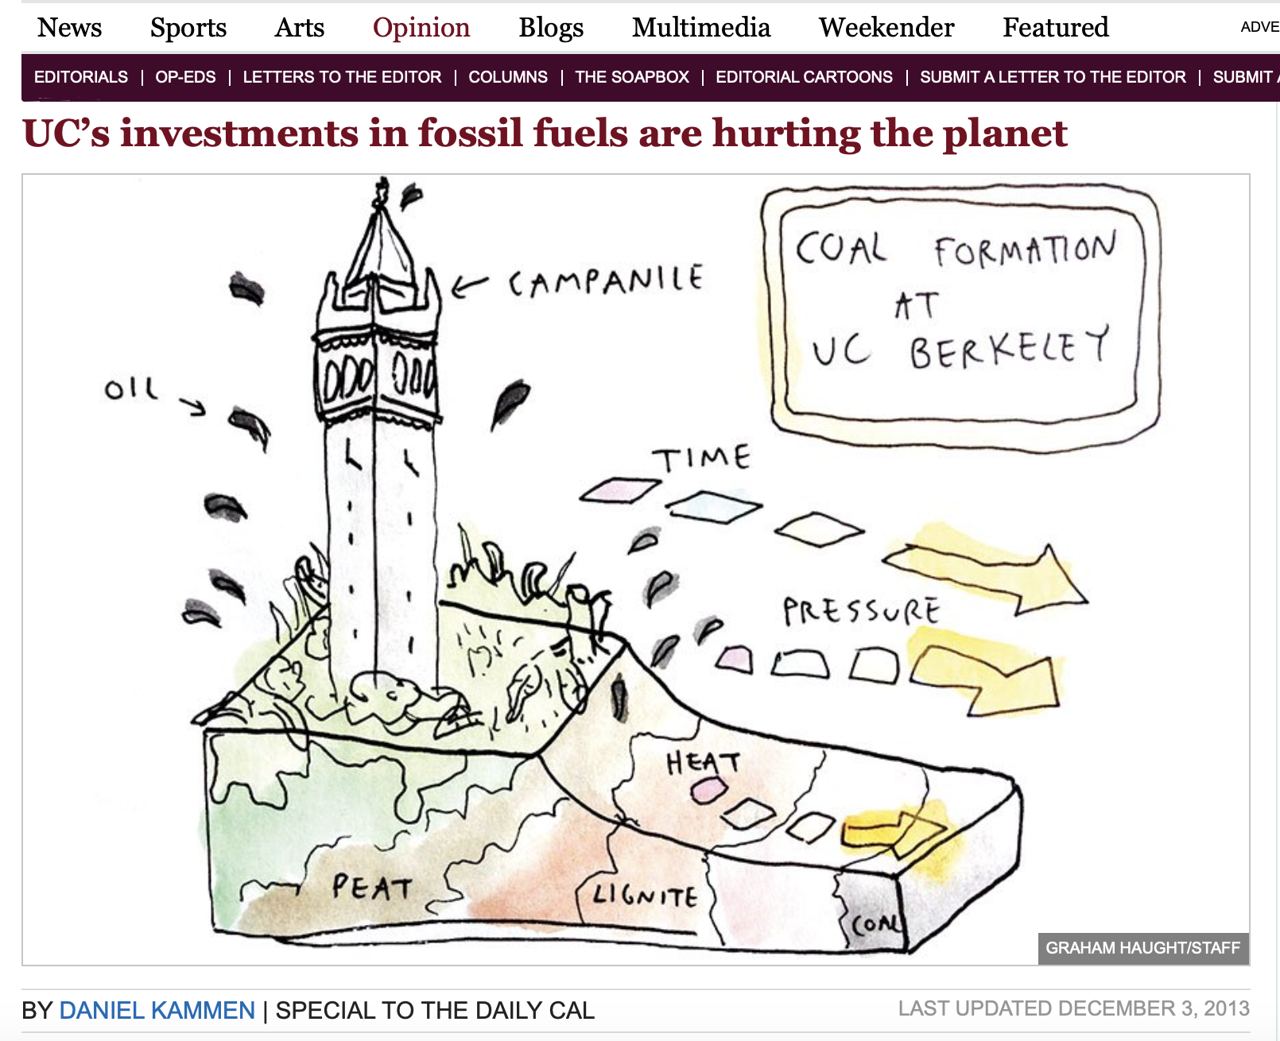
Notes:
Meeting URL:
https://ihe.britishcouncil.org/events/building-pipeline-incentivizing-stem-higher-education

